Slide 1
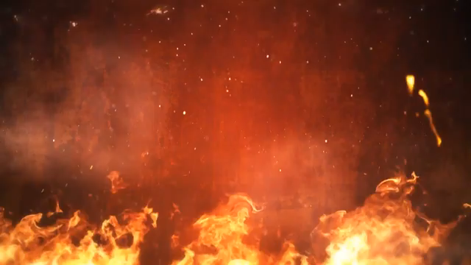
PROACTIVE DISASTER MANAGEMENT FOR FIRE HAZARDS

Slide 2
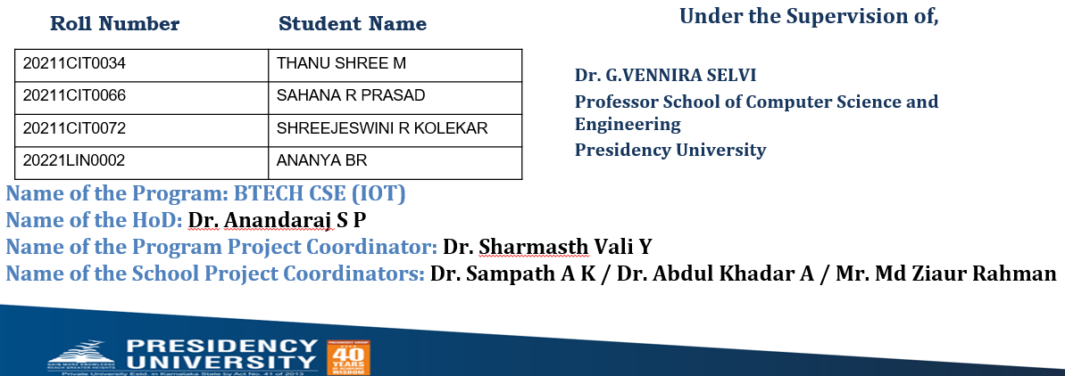
PIP2001 Capstone Project
Review-0
Batch Number:CIT-G31

Slide 3
content
REFERENCE
PROBLEM STATEMENT
TIMELINE OF THE PROJECT
ANALYSIS OF PROBLEM STATEMENT

Slide 4
Organization: PRESIDENCY UNIVERSITY
Category (Hardware / Software / Both) : BOTH
Difficulty Level: COMPLEX
Problem Description:
- Fire incident is a disaster that can potentially cause the loss of life,
property damage and permanent disability to the affected victim. Major fire
accidents do occur in industries like nuclear power plants, petroleum refineries,
gas tanks, chemical factories and other large-scale fire industries resulting in quite
serious consequences.
- Thousands of people have lost their lives in such mishaps.
Therefore, this project is enhanced to control fire through a robotic vehicle. With
the advancement in the field of Robotics, human intervention is becoming less
every day and robots are used widely for purpose of safety.
- In our day to day life fire accidents are very common and sometimes it becomes very difficult for fireman to save human life. In such case firefighting robot comes in picture.

Slide 5
Technology Stack Components:
The technology stack for a fire extinguishing robot with a phone alert system involves a combination of hardware and software components:
Detection: Sensors and data processing systems.
Extinguishing Mechanism: Actuators and extinguishing agents.
Navigation: Mobility systems and navigation sensors.
Communication: GSM, Wi-Fi, or Bluetooth modules, and mobile app integration.
Power Management: Batteries and power regulation.
Software: Embedded firmware, control algorithms, and communication protocols.
User Interface: Mobile apps or web dashboards for alert notifications and control.
Testing and Safety: Simulation tools and safety mechanisms.

Slide 6
Hardware Components:
- Microcontroller: Arduino board (e.g., Uno, Mega, Nano)
- Fire Detection: Sensors (thermal camera, smoke sensor, flame sensor, gas sensor)
- Fire Extinguishing: Water pump, foam generator, solenoids/valves, relays/transistors
- Navigation: Motors, motor driver module, ultrasonic sensors, IR sensors
- Communication: GSM module, Wi-Fi module (ESP8266), Bluetooth module
- Power Supply: Battery pack, voltage regulators
- User Interface: Buttons, display (optional)

Slide 7
Software Components:
Arduino Firmware: For sensor readings, fire detection logic, actuator control, and navigation
Communication Code: For GSM SMS alerts, Wi-Fi internet integration, Bluetooth communication
Phone Alert System Integration: Mobile app (optional), push notifications, web dashboard (optional)
Testing and Debugging: Serial Monitor, simulation tools

Slide 8
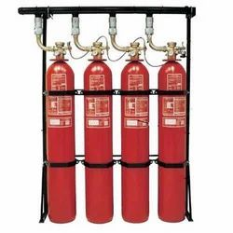
EXISTING SYSTEM :
- The common conventional firefighting methods involve fire brigades, portable fire
extinguisher (handheld) and sprinklers.
- These conventional methods consume a lot of time to reach the place of the mishap like the fire brigade must be deployed from the fire station should get through the traffic and reach the fire-struck area,
- A portable extinguisher is also no gift because it is generally placed in one of the
corners of the building that may be difficult to reach and need constant Maintenance.
- On the other hand, the sprinkler and smoke detector setup is very non
reliable method because the sprinkler pipes have any defects and may not provide enough
pressure and it is suited to cover large areas.

Slide 9
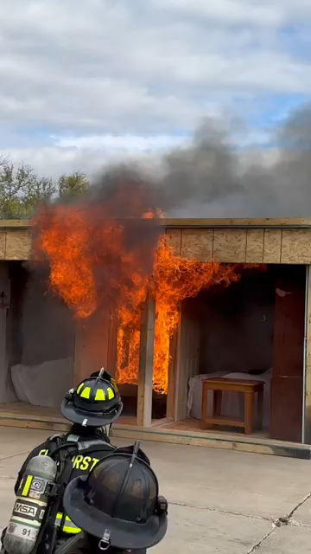
PROBLEMS IN EXISTING SYSTEM:
- The problem with the existing system is that exposure to hazardous and chaotic fire
Environment, rather than the fire itself, is the most significant cause of injury and
Death in fires.
- The reachability of precise information in real time on
The International journal of analytical and experimental modal analysis
The conditions directly at the center of the fire ground are a crucial factor in the
Guidance of rescue actions together with feasible counter-plans.
- Unfortunately the Firefighting environments are normally hard to reach and restricted in accessibility
- By obstacles, tumbledown architectures, and visibility by smoke, dangerous gases
Or dust. Therefore, the fire scene is an information-poor environment due to the lack
Of information on the location of the fire, firefighters, and victims, and the search and
Rescue opportunities were previously unimaginable due to a lack of situational
Conditions and real-time information for targeted decision-making. Due to this,
accidents occur.
- Additionally, the current methods applied in firefighting are
inadequate and inefficient relying heavily on humans who are prone to error, no
matter how extensively they have been trained.

Slide 10
PROPOSED SYSTEM
- The proposed model can detect the presence of fire using a flame sensor and
Calculates object distance using an ultrasonic sensor and moves the robot to fire
Accident location.
- It contains gear motors and a motor driver to control the movement
Of robot. When it detects fire it communicates with the microcontroller (Arduino
MEGA) and the robot will move towards the fire-affected area.
The fire extinguisher is mounted on the robotic vehicle which is then controlled over
the wireless communication to extinguish the fire automatically.

Slide 11

ADVANTAGES OF PROPOSED SYSTEM
➢ The robot will be used at places where it is dangerous for humans to enter.
➢ Capability of sensing accurately with increased flexibility.
➢ Reduce human effort.
➢ Reliable and economical.
➢ It reduces the time delay in reaching the affected area.
➢ It reduces the errors and limitations faced by human firefighters.
➢ Sensors have long lifetime and less cost

Slide 12
A TIMELINE ALWAYS WORKS WELL
PHASE 1
PHASE 3
PHASE 2
PHASE 4
1
2
3
4

Slide 13
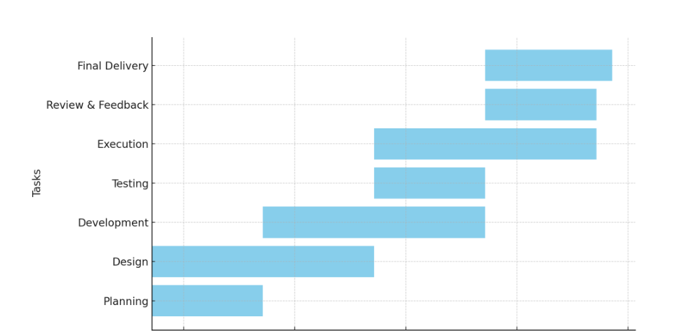
Timeline of the Project (Gantt Chart)

Slide 14
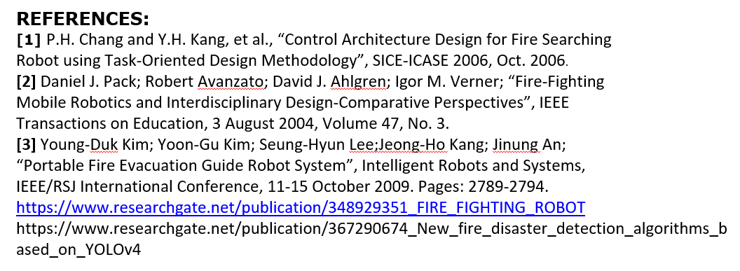

Slide 15


